Slide 1
LEGO ELEVATOR
Ambrus Bence tibor, d1o4nv

Slide 2
Concept
lego elevator
The idea was to build an elevator using:
LEGO
Arduino UNO
DC motor
motor driver circuit
lots of electrical components

Slide 3
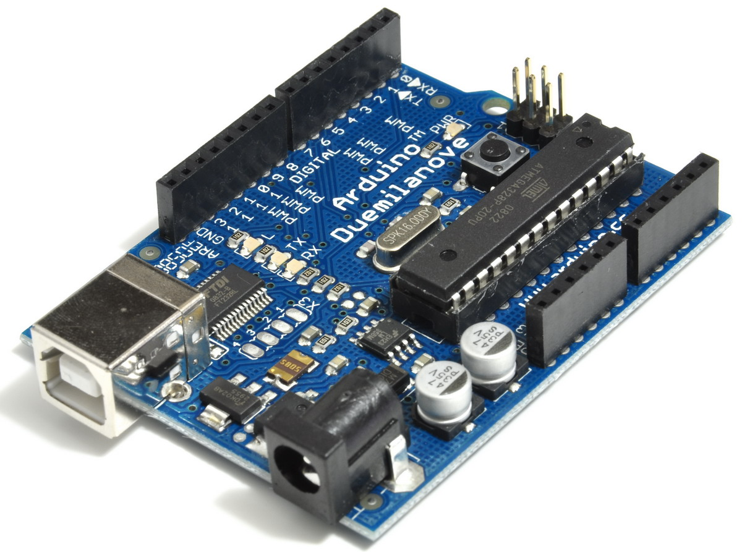
ARDUINO UNO R3
lego elevator
Shipment took very long
Difficulties with own board
Still using the borrowed one

Slide 4
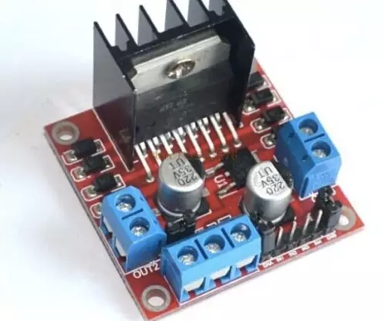
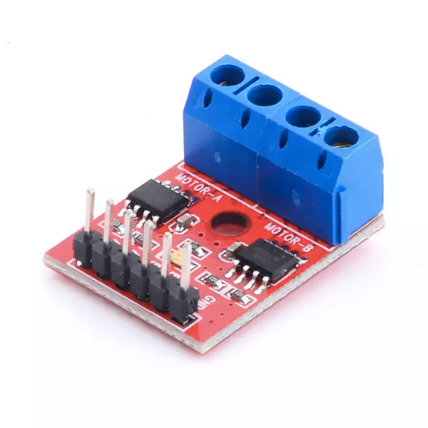
driver
lego elevator
Originally used an L298N:
+/- 1,5V was the max. output (?)
has PWM
Replaced with L9110:
works perfectly
doesn’t have PWM
smaller

Slide 5
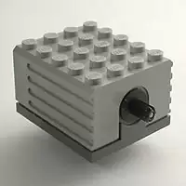
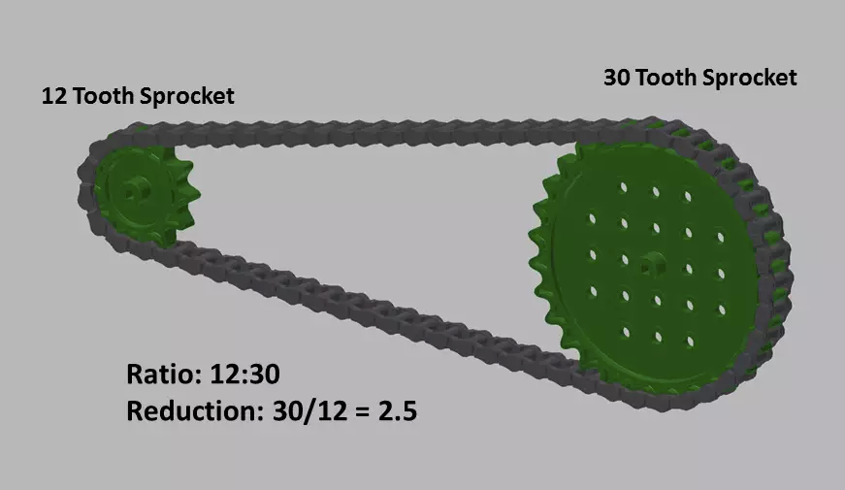
Electric Technic Motor 9V
lego elevator
ungeared
high speed
low torque
strong enough to lift cabin
gear reduction will be needed

Slide 6
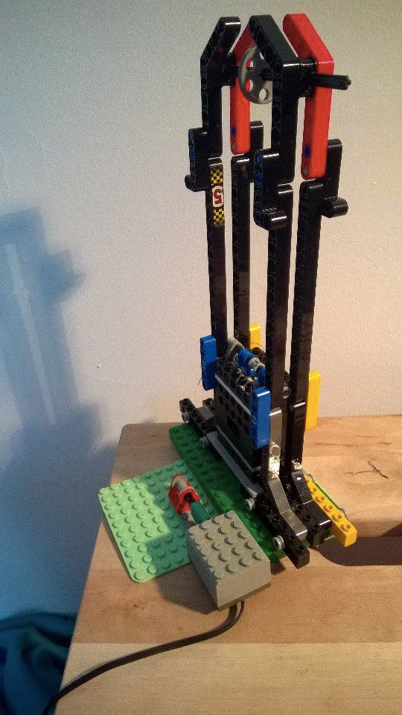
elevator
lego elevator
3-storey-tall
made of Technics elements
used thread but it always tears
replaced with fishing line (damil)
no horizontal swinging

Slide 7
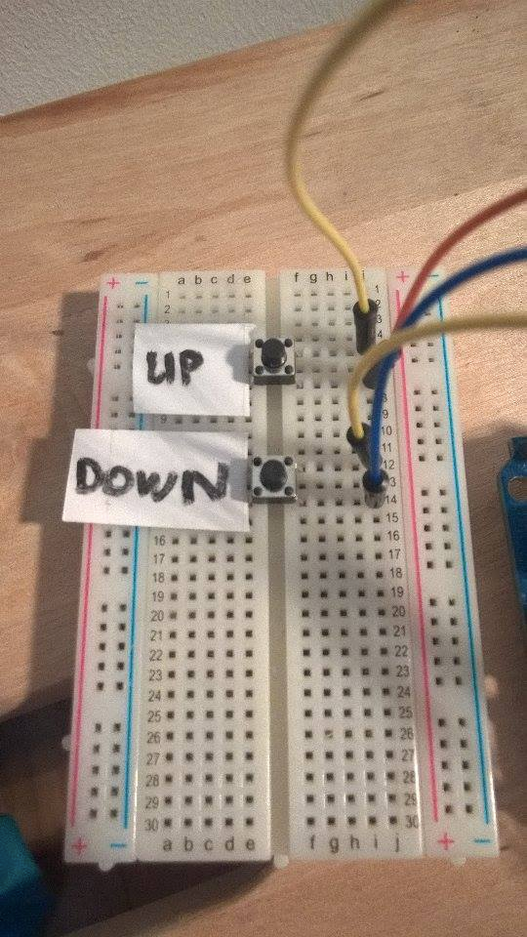
control unit
lego elevator
early stage
can move up and down
manual working
cannot be called from levels

Slide 8
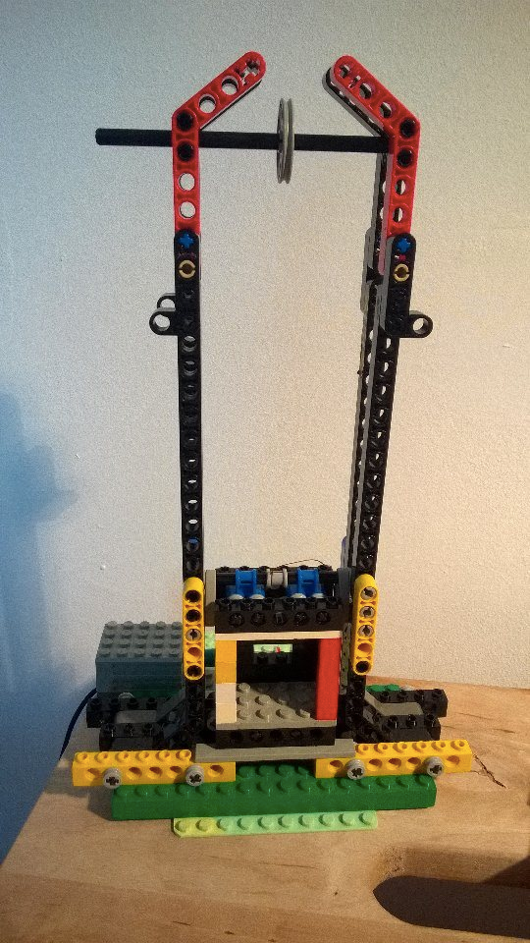
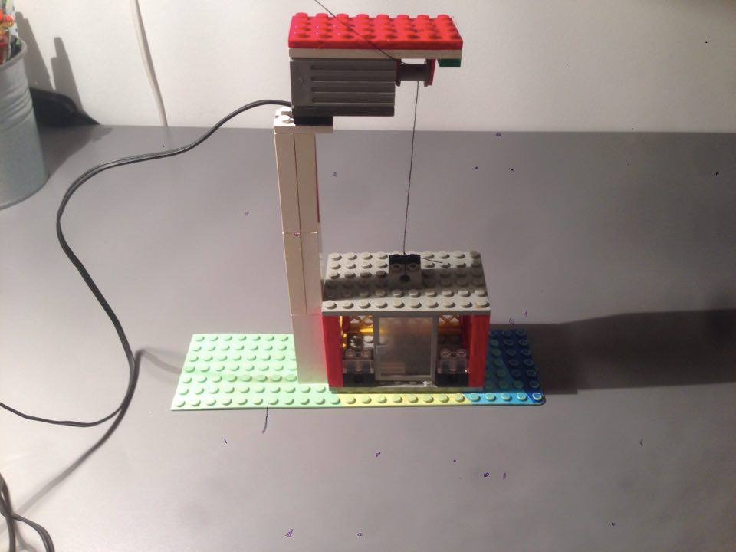
before - after
lego elevator

Slide 9
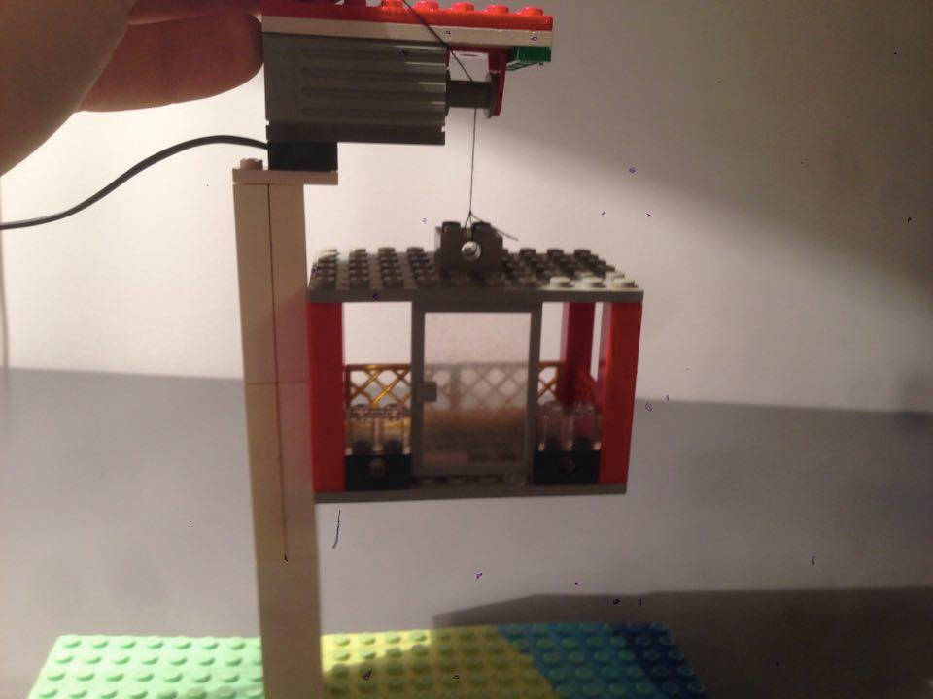
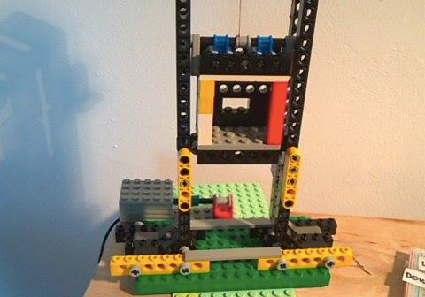
before - after
lego elevator

Slide 10
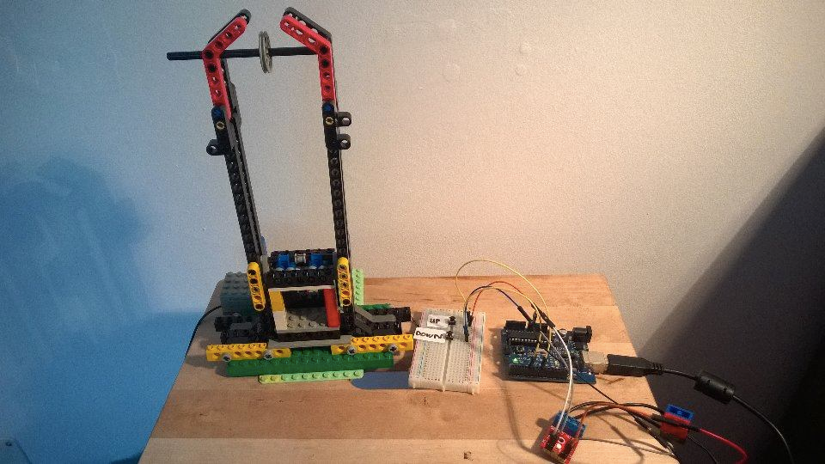
overall picture
lego elevator

Slide 11

right now
lego elevator
short time left…
bad time management and underestimating
barely any software is used yet
I have 5 weeks to save the semester

Slide 12

what is left
lego elevator
call buttons on elevator
level buttons on panel
sensors to identify actual floor
some fancy codes
gear reduction

